Slide 1
Databricks
Lecturer: Ngo Huy Bien
Software Engineering Department
Faculty of Information Technology
University of Science
Ho Chi Minh City, Vietnam
nhbien@fit.hcmus.edu.vn

Slide 2

Objectives

Slide 3

Contents

Slide 4

References

Slide 5
Databricks
https://docs.databricks.com/en/introduction/index.html
Databricks is a unified, open analytics platform for building, deploying, sharing, and maintaining enterprise-grade data, analytics, and AI solutions at scale.
The Databricks Data Intelligence Platform integrates with cloud storage and security in your cloud account, and manages and deploys cloud infrastructure on your behalf.
The following technologies are open source projects founded by Databricks employees:
Delta Lake and Delta Sharing
Mlflow
Apache Spark and Structured Streaming
Redash

Slide 6
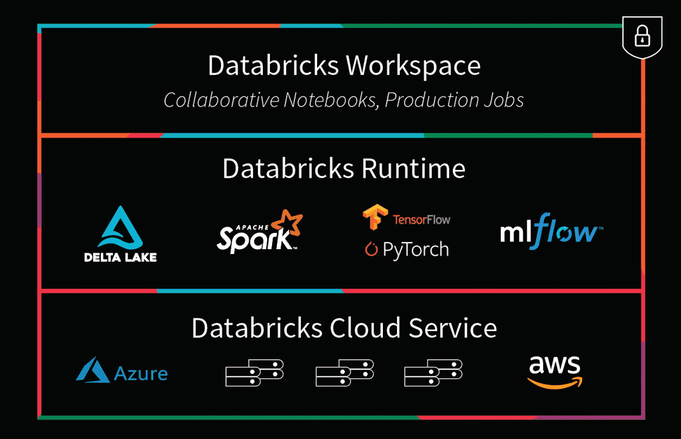
Databricks vs. Apache Spark
https://www.databricks.com/spark/comparing-databricks-to-apache-spark
Databricks builds on top of Spark and optimizes for performance.

Slide 7
1. Register Account
https://accounts.cloud.databricks.com

Slide 8
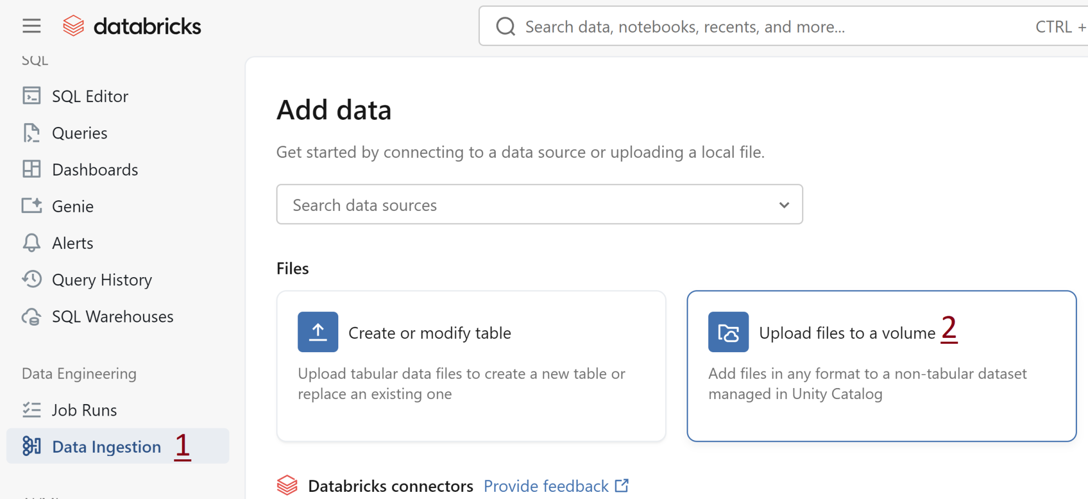
2. Upload a Data File

Slide 9
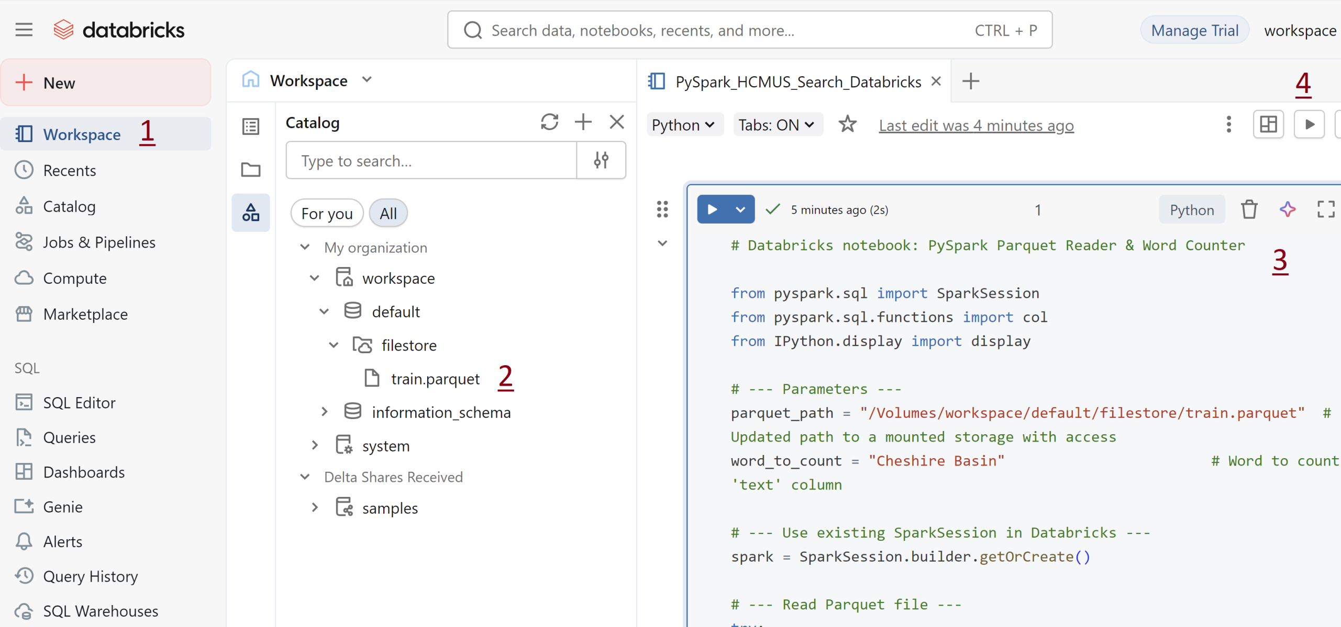
3. Run Spark App

Slide 10


Slide 11
Amazon EMR
https://docs.aws.amazon.com/emr/latest/ManagementGuide/emr-what-is-emr.html
Amazon EMR (previously called Amazon Elastic MapReduce) is a managed cluster platform that simplifies running big data frameworks, such as Apache Hadoop and Apache Spark, on AWS to process and analyze vast amounts of data.
Using these frameworks and related open-source projects, you can process data for analytics purposes and business intelligence workloads.
Amazon EMR also lets you transform and move large amounts of data into and out of other AWS data stores and databases, such as Amazon Simple Storage Service (Amazon S3) and Amazon DynamoDB.

Slide 12
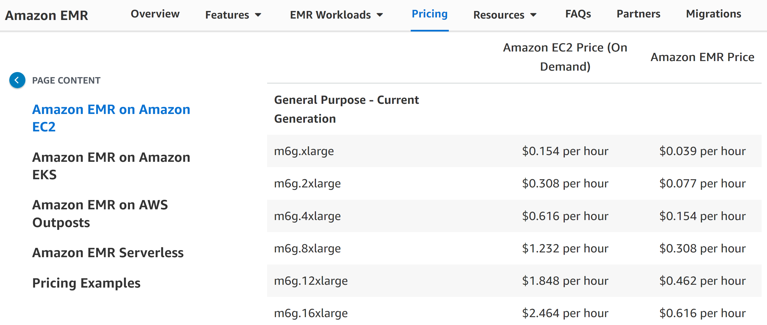
Pricing
https://aws.amazon.com/emr/pricing/

Slide 13
Prepare Storage for Amazon EMR
https://docs.aws.amazon.com/emr/latest/ManagementGuide/emr-gs.html
When you use Amazon EMR, you can choose from a variety of file systems to store input data, output data, and log files.
EMRFS is an implementation of the Hadoop file system that lets you read and write regular files to Amazon S3.

Slide 14
Dataset Sample Rows
The input data is a modified version of Health Department inspection results in King County, Washington, from 2006 to 2020.
Refer to the food_establishment_data.csv file.
name, inspection_result, inspection_closed_business, violation_type, violation_points
100 LB CLAM, Unsatisfactory, FALSE, BLUE, 5
100 PERCENT NUTRICION, Unsatisfactory, FALSE, BLUE, 5
7-ELEVEN #2361-39423A, Complete, FALSE, , 0

Slide 15
Example PySpark Script for EMR
Refer to the health_violations.py file.
import argparse
from pyspark.sql import SparkSession
def calculate_red_violations(data_source, output_uri):
with SparkSession.builder.appName("Calculate Red Health Violations").getOrCreate() as spark:
# Load the restaurant violation CSV data
if data_source is not None:
restaurants_df = spark.read.option("header", "true").csv(data_source)
...

Slide 16
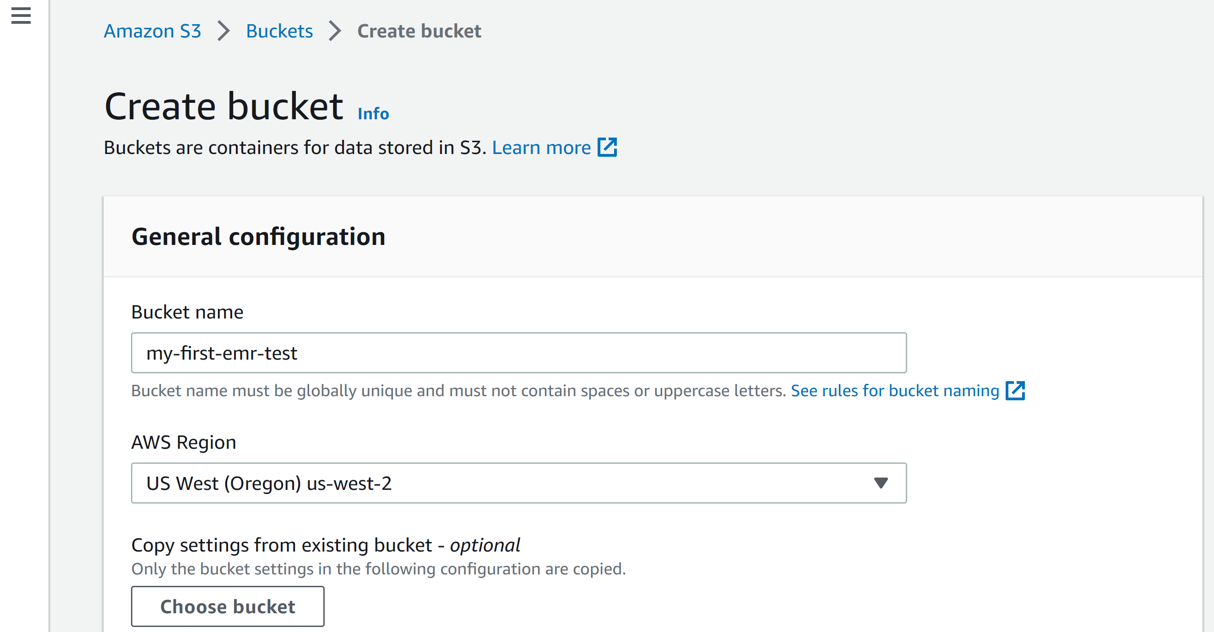
1. Create a Bucket

Slide 17
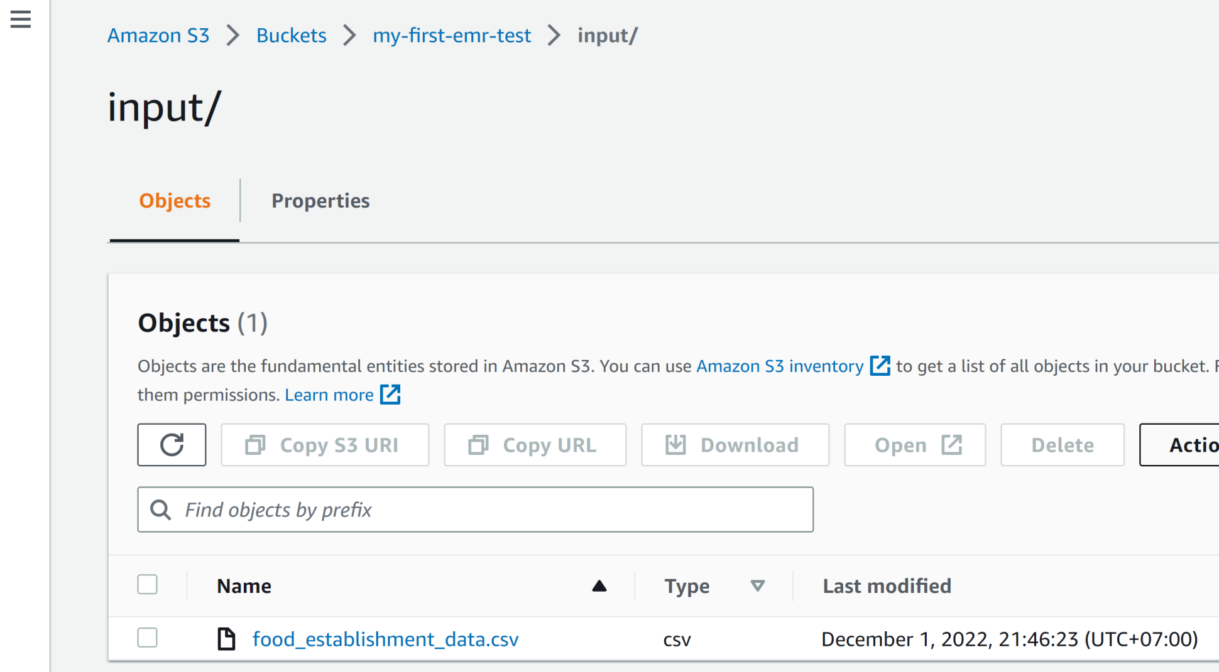
2. Upload Script and Input

Slide 18

Thank You & See You Again

